Slide 1
Lucile Lahaylahay
Sales Manager

Slide 2
An Overview of the Concept
Introduction
What is BLUE SHIELD?
HiAdvance active campaign for safer, healthier environment. We aim to educate both industries and individuals for a lifestyle that values health and the environment by marking establishments with our Blue Shield mark.

Slide 3
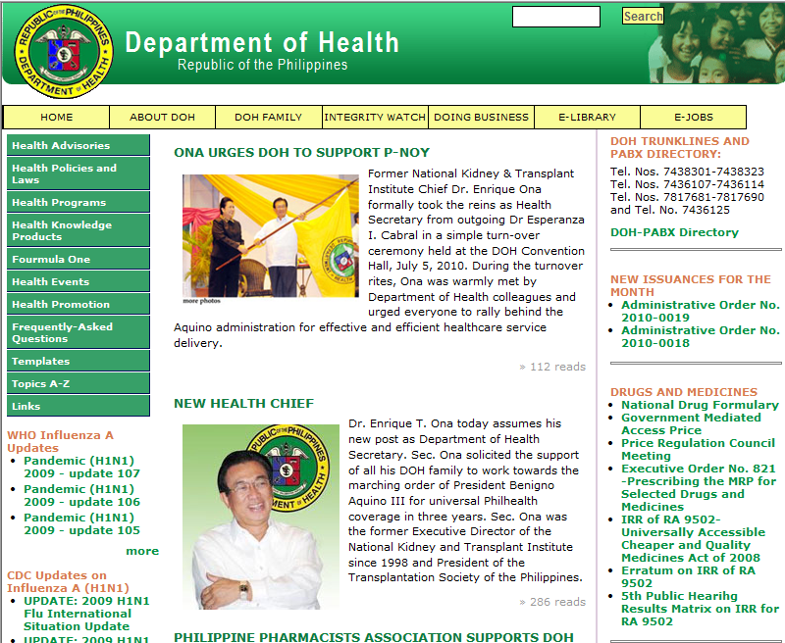
An Overview of the Concept
Introduction
What does it mean?
The Blue Shield mark is given to the establishment and industries being monitored by HiAdvance in compliance with the water quality monitoring (drinking water and waste water) set forth by local regulating bodies such as Municipalities, DENR and DOH

Slide 4
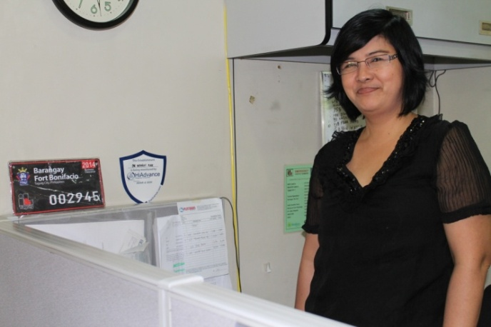
An Overview of the Concept
Introduction
By having the “Blue Shield” mark” in your establishment, you are conveying the message that you are among those who believe in the needed change.
The way we treat our body and the environment,
This will make sure that you are advocating the change.

Slide 5
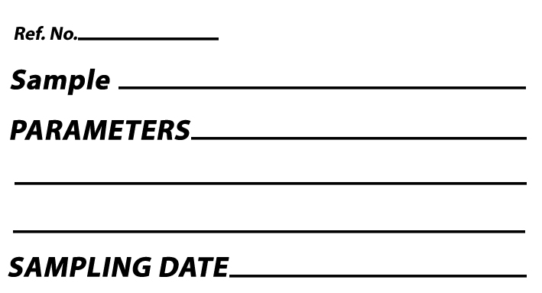
An Overview of the Concept
Introduction
Technical Details

Slide 6
An Overview of the Concept
Introduction
Cost of Having
Blue Shield
FREE!

Slide 7
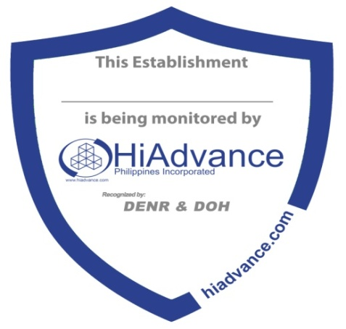
An Overview of the Concept
Introduction
Your
PARTNER
for Your
Environmental
compliance!
Join us NOW!

Slide 8
Thank You!!!!

